Slide 1
Review
Write a balanced chemical equation for:
The reaction of propane with one mole equivalent of bromine water (in presence of UV light).
The reaction of propane in excess bromine water (in presence of UV light).

Slide 2
Fuels
Lucarelli Ch 13.7-13.12, Set 22

Slide 3
Objectives
Discuss the benefits and drawbacks of using hydrocarbons as fuels, including the effect on the environment.
Compare the effectiveness and suitability of different fuels, including hydrocarbons and biofuels (biogas, biodiesel, bioethanol), and suggest why certain fuels are used.

Slide 4
Fuels
Fuels: substances that release heat energy when they are combusted.
Fossil fuels: coal, oil, natural gas
Biofuels: biodiesel, bioethanol, biogas
These fuels produce varying amounts of energy and carbon emissions (CO₂)

Slide 5
Examples
Bioethanol:
C₂H₅OH + 3 O₂ → 2 CO₂ + 3 H₂O + 1367 kJ
Natural Gas
CH₄ + 2 O₂ → CO₂ + 2 H₂O + 890 kJ
Petrol
2 C₈H₁₈ + 25 O₂ → 16 CO₂ + 18 H₂O + 10940 kJ

Slide 6
*Fuel Value and CO₂ emission*
Fuel value (kJ g⁻¹) = heat energy (kJ mol⁻¹) / molecular weight (g mol⁻¹)
Higher the fuel value the better, for energy purposes.
Carbon emissions (CO₂) measured in mass of CO₂ per MJ of energy released (i.e. g MJ⁻¹)

Slide 7
Compare the effectiveness and suitability of different fuels, including hydrocarbons and biofuels (biogas, biodiesel, bioethanol), and suggest why certain fuels are used.
 | Fuel Value [MJ kg⁻¹] | Carbon emissions [g(CO₂) MJ⁻¹]
Coal | 24-30 | 90-95
Natural Gas | 47 | 51
LNG | 49 | 51
LPG | 49 | 59
Petrol | 46 | 66
Diesel | 46 | 70
Notes:
Bioethanol Fuel value of 85 kJ g-1

Slide 8
Compare the effectiveness and suitability of different fuels, including hydrocarbons and biofuels (biogas, biodiesel, bioethanol), and suggest why certain fuels are used.
Biofuels: produced from biomass and are alternatives to fossil fuels.
These resources are renewable as they originate from organic matter and their use results in lower carbon emissions. They are considered ‘carbon neutral’.
Ethanol fermentation: C₆H₁₂O₆ → 2 C₂H₅OH + 2 CO₂
Photosynthesis: 6 CO₂ + 6 H₂O → C₆H₁₂O₆ + 6 O₂
Combustion: C₂H₅OH + 3 O₂ → 3 H₂O + 2 CO₂

Slide 9
How much more environmentally friendly is ethanol than petrol?
On a simple litre-per-litre basis, ethanol produces 1.5kg of carbon dioxide (CO₂) compared to 2.2kg produced by petrol. However, ethanol produces less energy than petrol so 1.4L of ethanol (which produces 2.15kg of CO₂) contains the same amount of energy as 1L of petrol^{iv}. While this suggests the difference to the environment is small, the CO₂ produced by ethanol-blended fuel use is countered somewhat by the CO₂ consumed by the plants used to produce the ethanol, with estimates attributing a carbon dioxide saving of 70% once all production and distribution factors have been taken into ^{v}.
Notes:
https://www.allianz.com.au/car-insurance/news/ethanol-versus-petrol-faq

Slide 10
Practice
Lucarelli Chapter 13.7 – 13.12, Set 22 (q9-onwards)

Slide 11
Ideal Gases

Slide 12
Objectives
Kinetic Theory and Ideal Gases
The Ideal Gas equation
Empirical formula from combustion data

Slide 13
Kinetic Theory
Gases are composed of particles that are in rapid continuous random motion.
Attraction and repulsion between particles is negligible.
The average kinetic energy of the particles of a gas is proportional to its temperature and is the same for all gases at the same temperature.
Particle collisions are elastic. Over time as particles collide they do not lose speed or slow down.

Slide 14
Properties of Gases
Take the shape of their container.
Can be compressed.
Readily diffuse through other gases.
Exert pressure.

Slide 15
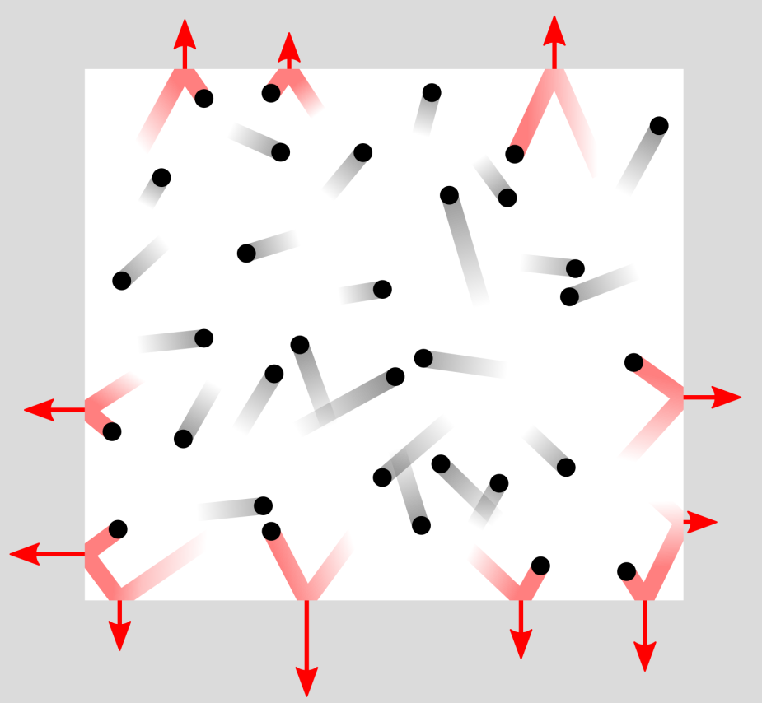
Gases consist of particles in constant random motion, spread a long way apart.
When gases collide with the walls of their container, each collision exerts a force. This causes a pressure to be exerted on the walls of the container, that is, a force per unit area.
Pressure is measured in Pascals, 1 Pa = 1 N/m².
We also measure pressure in atmospheres, where 1 atm = 101.3 kPa.
Notes:
Boardworks A2 Physics
Thermal Physics

Slide 16
An Ideal Gas
Ideal gas molecules do not attract or repel each other. The only interaction between ideal gas molecules would be an elastic collision upon impact with each other or an elastic collision with the walls of the container.
Ideal gas molecules themselves take up no volume. The gas takes up volume since the molecules expand into a large region of space, but the Ideal gas molecules are approximated as point particles that have no volume in and of themselves.

Slide 17
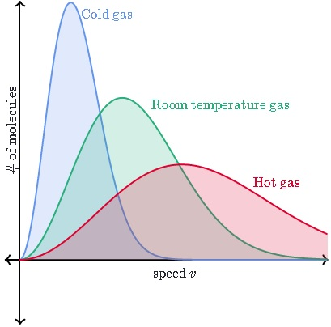
Kinetic energy and temperature
The Maxwell-Boltzmann distribution - The distribution of kinetic energies of particles at a given temperature.
Notes:
Boardworks A2 Physics
Thermal Physics

Slide 18
Measuring temperature
The absolute or thermodynamic scale of temperature is a measure of the average kinetic energy of the particles. It is measured in degrees Kelvin (K). When temperature is measured in Kelvin, the temperature of a substance is directly proportional to the average kinetic energy of its particles.
Absolute temperature starts at absolute zero – the theoretical lowest possible temperature, at which point the particles would have no kinetic energy. The absolute scale has units of the same magnitude as the Celsius scale.
Converting to and from Kelvin and degrees Celsius:
T (K) = T (°C) + 273.15
T (°C) = T (K) - 273.15
Notes:
18
Teacher notes
The absolute scale of temperature (sometimes just absolute temperature) is related to the efficiency of heat engines – these are devices that convert thermal energy input into mechanical energy output. This concept is beyond standard A-Level.
Students should note that absolute zero cannot be reached – they could be asked to explain why this is impossible once they have studied Charles’ law (i.e. at absolute zero, a substance would have zero volume).
Boardworks A2 Physics
Thermal Physics

Slide 19
Applying kinetic theory
Gases diffuse quickly because gas particles move rapidly and randomly through the large amount of empty space between particles to spread out.
Gases are easily compressed due to the large amount of empty space between particles.
Gases spread out to fill a container due to the negligible forces of attraction between particles.
Gases exert pressure because the particles move rapidly and collide with the interior surfaces of the container.
Gases have low densities due to the large amount of space between particles.
Notes:
Boardworks A2 Physics
Thermal Physics

Slide 20
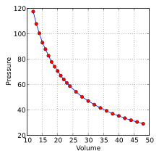

Boyle’s Law
The pressure of a given mass of an ideal gas is inversely proportional to its volume at a constant temperature.
V ∝ , where T = constant
P₁V₁ = P₂V₂

Slide 21
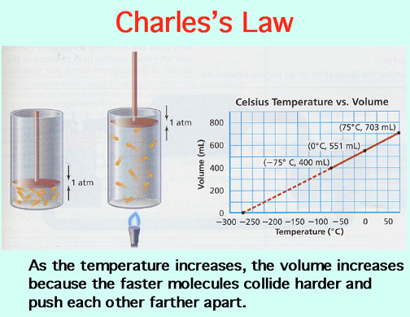
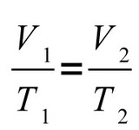
Charles’ Law
The volume of an ideal gas at constant pressure is directly proportional to the absolute temperature.
V ∝ T

Slide 22
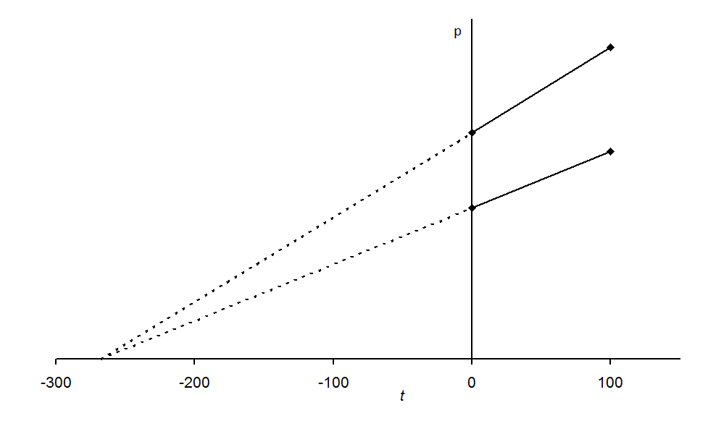
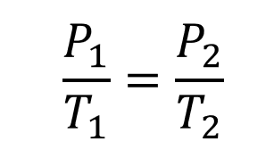
Gay Lussac Law
For a fixed mass of gas, at a constant volume, the pressure (p) is directly proportional to the absolute temperature (T).

Slide 23
Gas laws
From Boyle’s law, for a fixed mass of an ideal gas at constant temperature:
pV = constant
From Charles' law, for a fixed mass of an ideal gas at constant pressure:
V / T = constant
From the Gay Lussac’s law, for a fixed mass of an ideal gas at constant volume:
p / T = constant
Combining the three gives:
pV / T = constant
Notes:
23
Boardworks A2 Physics
Thermal Physics

Slide 24
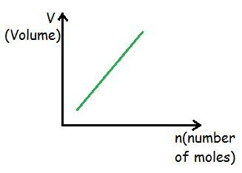
Avogadro’s law
Avogadro’s law states that equal volumes of different gases at the same pressure and temperature will contain equal numbers of particles.
For example, if there are 2 moles of O₂ in 50 mL of oxygen gas, then there will be 2 moles of N₂ in 50 mL of nitrogen gas and 2 moles of CO₂ in 50 mL of carbon dioxide gas at the same temperature and pressure.
The volume that a gas occupies will depend on the number of moles of the gas.
Notes:
Boardworks A2 Physics
Thermal Physics

Slide 25
Molar volumes of gases
If the temperature and pressure are fixed at convenient standard values, the molar volume of a gas can be determined.
At standard temperature and pressure (273 K & 100 kPa), 1 mole of any gas occupies a volume of 22.71 L.
Example: What volume does 5 moles of CO₂ occupy at standard temperature and pressure?
volume occupied = no. moles × molar volume
= 5 × 22.71
= 113.55 L
Notes:
Teacher notes
The definition of standard temperature and pressure varies from source to source. The most recent IUPAC (International Union of Pure and Applied Chemistry) definition is 273 K / 100 kPa, although its old definition was 273 K / 101 kPa. Other common definitions include 293 K / 101 kPa (the National Institute of Standards and Technology (NIST)).
At 25°C / 100 kPa, the molar volume of an ideal gas is 2.48 × 10⁻² m³.
Molar volume is sometimes expressed in dm³, where 1 dm³ = 0.001 m³. These units are generally used by chemists.
Boardworks A2 Physics
Thermal Physics

Slide 26
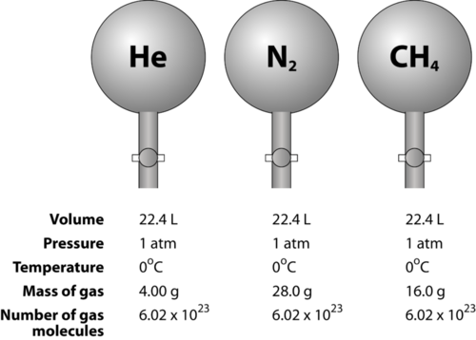
One mole of any gas occupies 22.71 L at STP

Slide 27
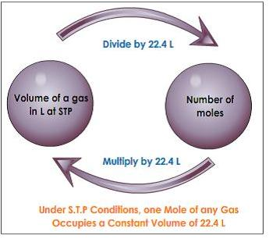
One mole of any gas occupies 22.71 L at STP

Slide 28
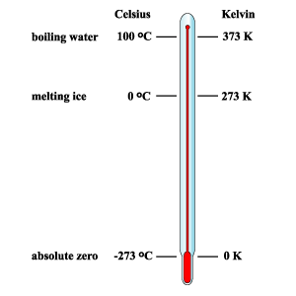
Ideal Gas Law
PV = nRT
P = pressure, kPa
V = Volume, L
n = moles, mol
R = 8.314 J K⁻¹ mol⁻¹
T = Temperature, K
STP: 100 kPa, 0 C

Slide 29
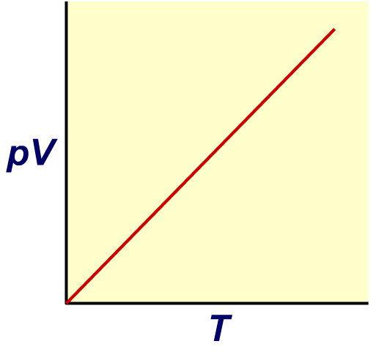
pV / T graph: calculating number of moles
Plotting pV against T for an ideal gas:
pV = nRT, so pV / T = nR
Therefore gradient of the graph is equal to nR.
R is a constant, the number of moles can be calculated from the gradient.
n = pV/RT
Notes:
Boardworks A2 Physics
Thermal Physics

Slide 30
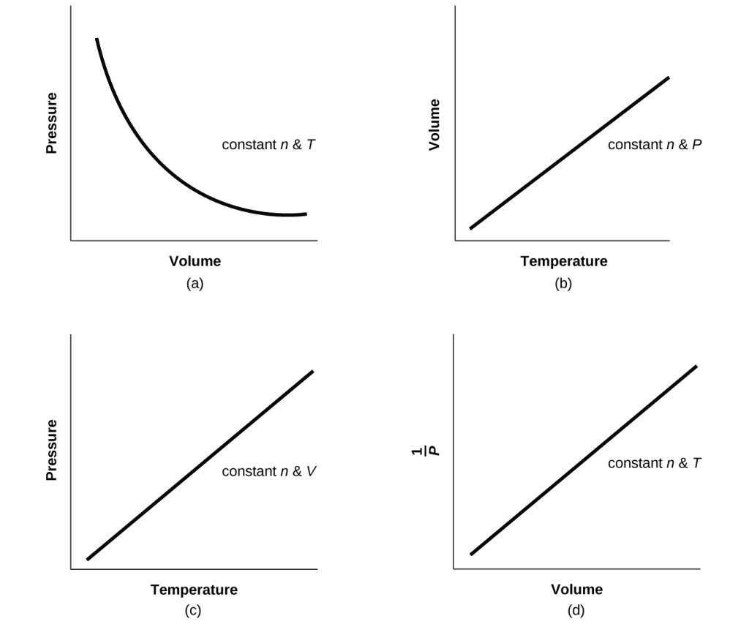

Slide 31
Energy

Slide 32
Enthalpy
The internal energy of the system.
The symbol, H (J or kJ).
Change in enthalpy, ΔH (J or kJ)
ΔH = H (products) – H (reactants)

Slide 33
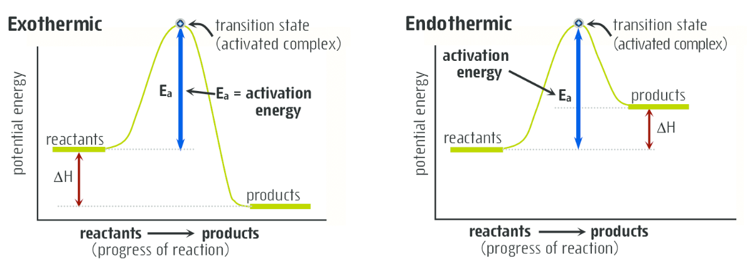

Slide 34
Example
Draw a labelled energy profile diagram with reactants (15 kJ) and products (35 kJ) and an activation energy of (40 kJ).
Calculate the enthalpy of the reaction (ΔH).
Is this reaction exothermic or endothermic?

Slide 35
Heat of Combustion
You will need to apply the rule:
∆H = − mc∆T where ∆H = enthalpy change (J)
m = mass of water being heated by the burning alcohol (kg)
c = specific heat capacity of the water being heated (4.18 x 10³ J kg⁻¹ °C⁻¹)
∆T = change in temperature of water being heated (°C)

Slide 36
Practice
Kinetic Theory: Lucarelli Set 1 p 5-6
Ideal Gases: STAWA Set 26 p 163-164
Energy: Lucarelli Chapter 13 Set 22 p 111-114
STAWA Set 38 and 39 p 193-196

Slide 37
A sample of hex-2-ene is made to react with hydrochloric acid. Write a chemical equation to illustrate this reaction. Note all possible isomers and name the products.
A sample of 4-iodopent-2-ene is made to react with bromine water. Write a chemical equation to illustrate this reaction. Note all possible isomers and name the product.

Slide 38
Review
Propene is made to react with hydrogen gas in the presence of a platinum catalyst. The resulting product (2.03 g) is then combusted in excess oxygen gas. What volume of O₂ is required to completely react with the abovementioned product at STP?

Slide 39
The major component of petrol (octane, 6.70 g) is combusted in a limited amount of oxygen. The carbon containing gas produced was stored in a 1.5 L container at 45 C.
A) What is the pressure in the container in kPa? (6 marks)
B) The change in enthalpy is -5100 kJ and the initial enthalpy of the reactants is 7050 kJ. What is the enthalpy of the products? (1 mark)
C) Given the activation energy of the combustion is 900 kJ, draw an energy profile diagram to represent the progress of this reaction. (8 marks)
D) Explain, using your knowledge of ideal gases, how the pressure exerted and energy released in this reaction would change if the octane was burned in excess oxygen. (short answer 4 marks, long answer 10 marks)

Slide 40
The major component of petrol (octane, 6.70 g) is combusted in a limited amount of oxygen. The carbon containing gas produced was stored in a 1.5 L container at 45 C.
What is the pressure in the container in kPa? (6 marks) 828 kPa
The change in enthalpy is -5100 kJ and the initial enthalpy of the reactants is 7050 kJ. What is the enthalpy of the products? (1 mark) 1950 kJ
Given the activation energy of the combustion is 900 kJ, draw an energy profile diagram to represent the progress of this reaction. (4 marks)
Explain, using your knowledge of ideal gases, how the pressure exerted and energy released in this reaction would change if the octane was burned in excess oxygen. (short answer 4 marks, long answer 10 marks)

Slide 41
Practice
Lucarelli Chapter 12 Hydrocarbons (Set 20-21)
Lucarelli Chapter 13.8-13.12 Fuels (Set 22)
Lucarelli Chapter 11.1-11.3 Stoichiometry (Set 17)
STAWA Sets 29, 40-42

Slide 42
Practice
Kinetic Theory: Lucarelli Set 1 p 5-6
Ideal Gases: STAWA Set 26 p 163-164
Energy: Lucarelli Chapter 13 Set 22 p 111-114
STAWA Set 38 and 39 p 193-196

